Slide 1

TENNIS PROJECT
Data Science and Machine Learning Boot Camp

Slide 2
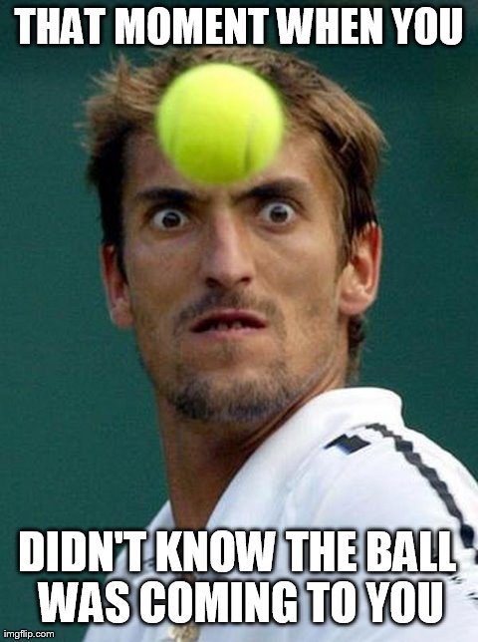
This is me ...
when see the dataset for the first time.
But then ...

Slide 3
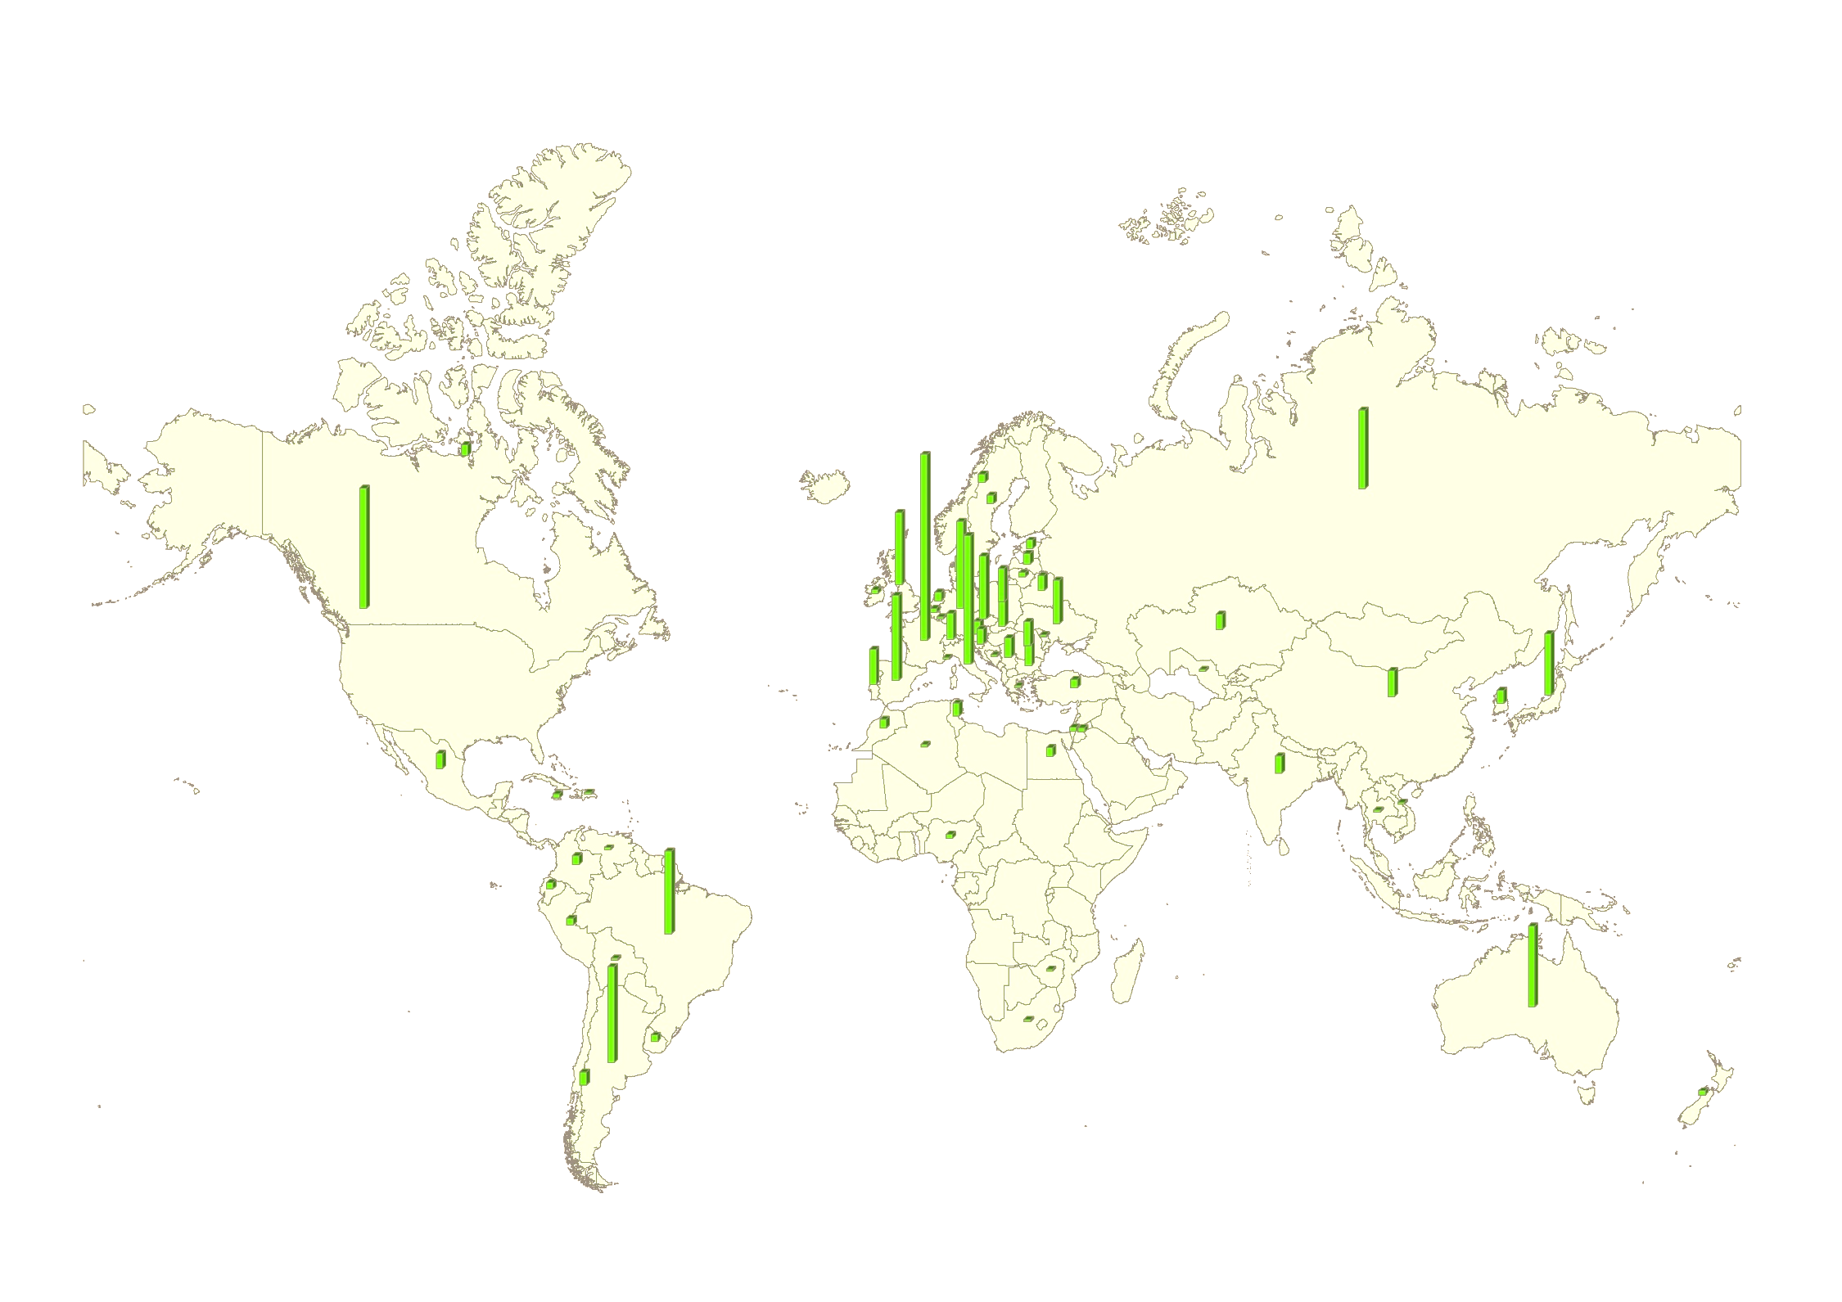
Players Distribution Around the World
5 کشوری که به ترتیب بیشترین تعداد بازیکنان را دارند:
فرانسه
ایتالیا
آمریکا
آرژانتین
آلمان
تعداد بازیکنان: 596 نفر
تعداد کشورهای شرکت کننده: 70 کشور

Slide 4
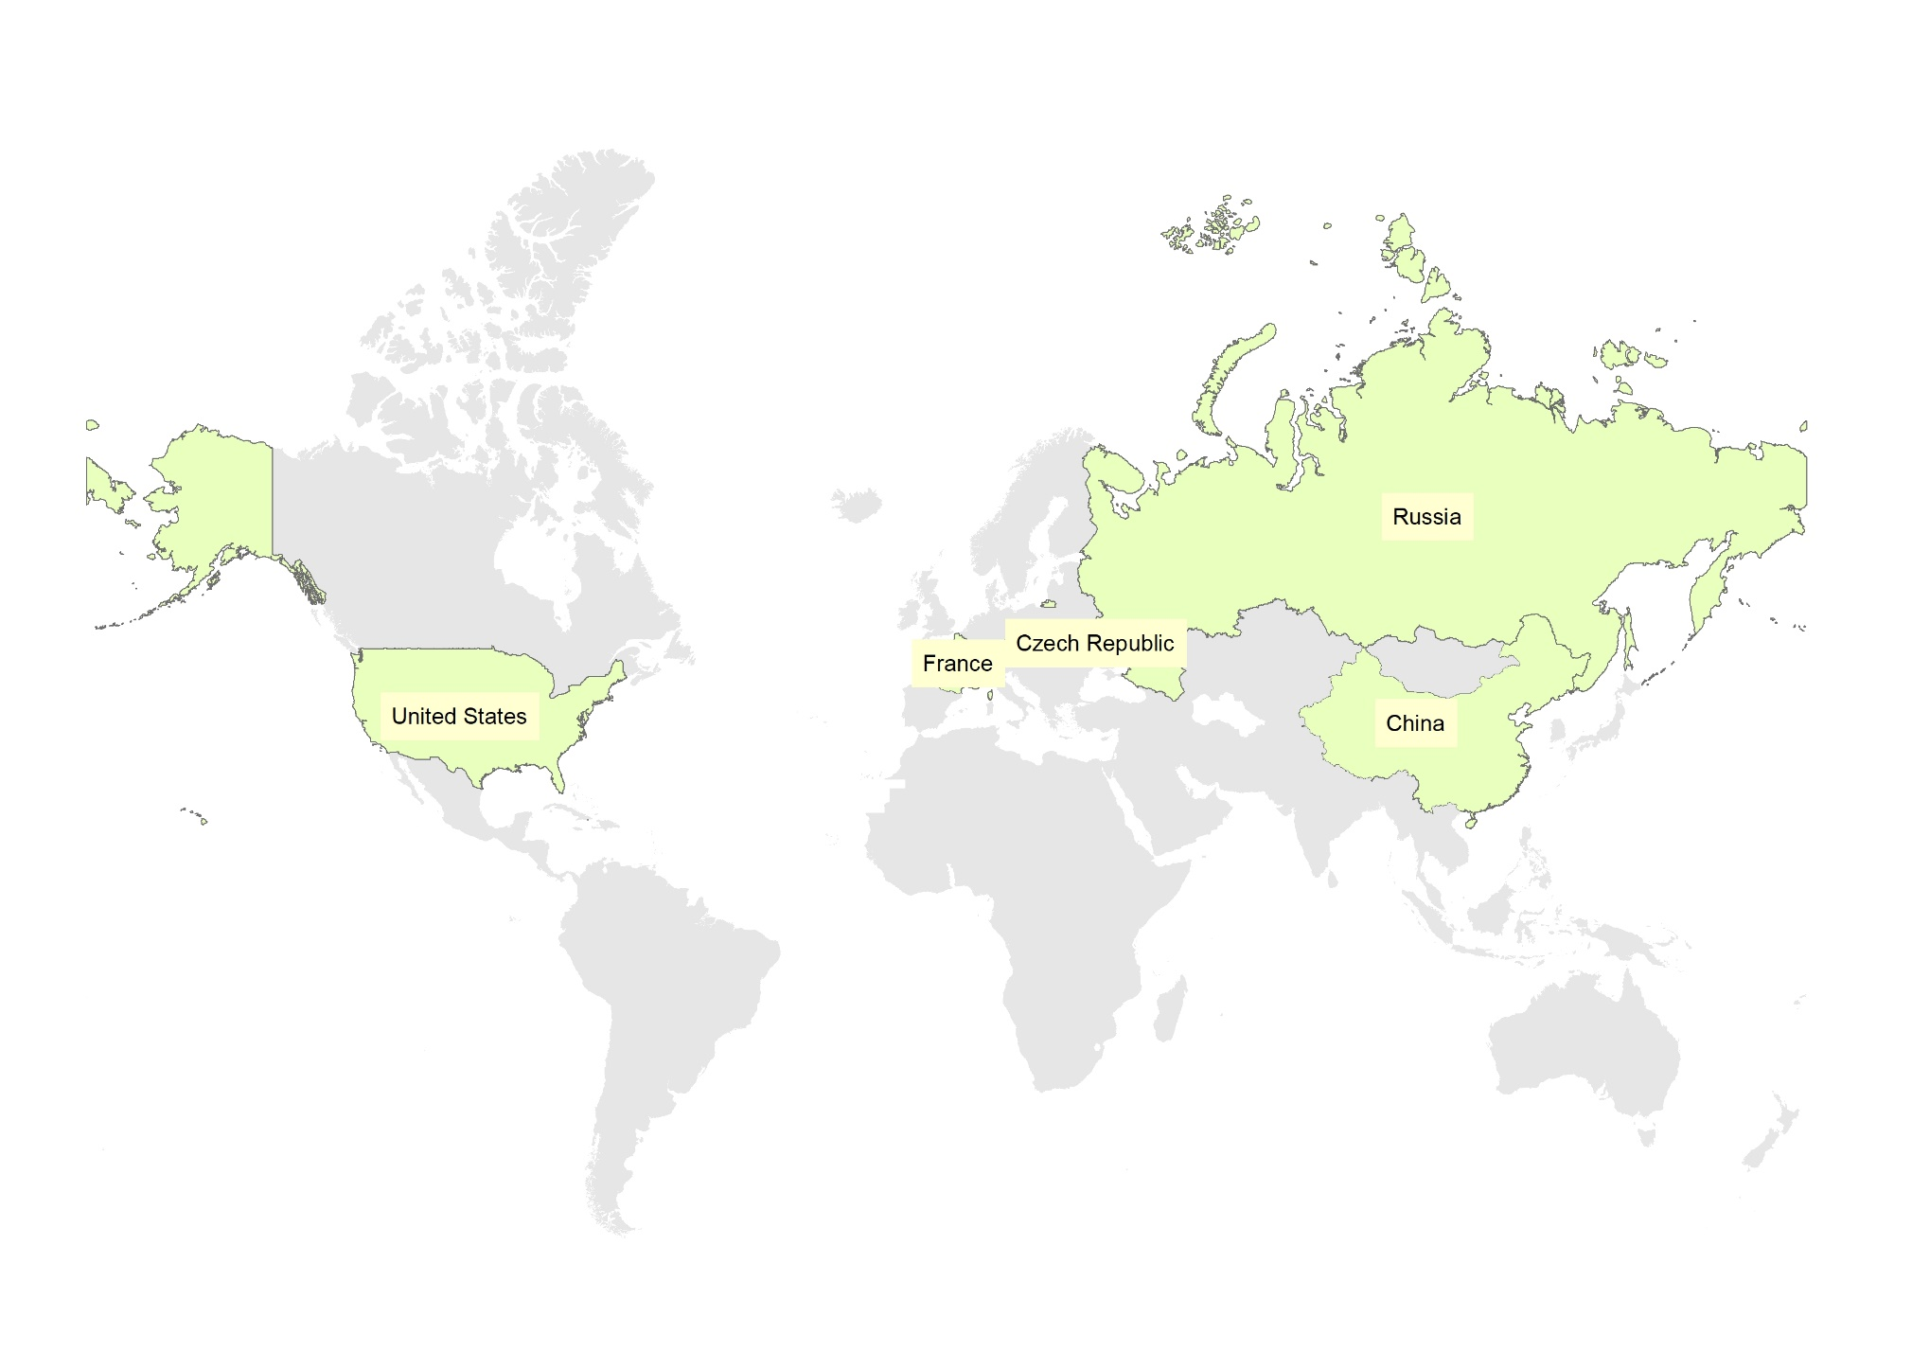
Top 100 Ranked Players Around the World
Country | Number
Czech Republic | 9
USA | 8
Russia | 6
France | 5
China | 5

Slide 5


Distribution of Men and Women
Number of Players | Share
358
238

Slide 6

Distribution of Left and Right Hand Players
Left-handed players
Base on the available data we have 32 left-handed players which is 12 percentage of players. Additionally, most of them are male.
Right-handed players
The majority of players are right handed. Base on the available data we have 244 left-handed players which is 88 percentage of players.

Slide 7
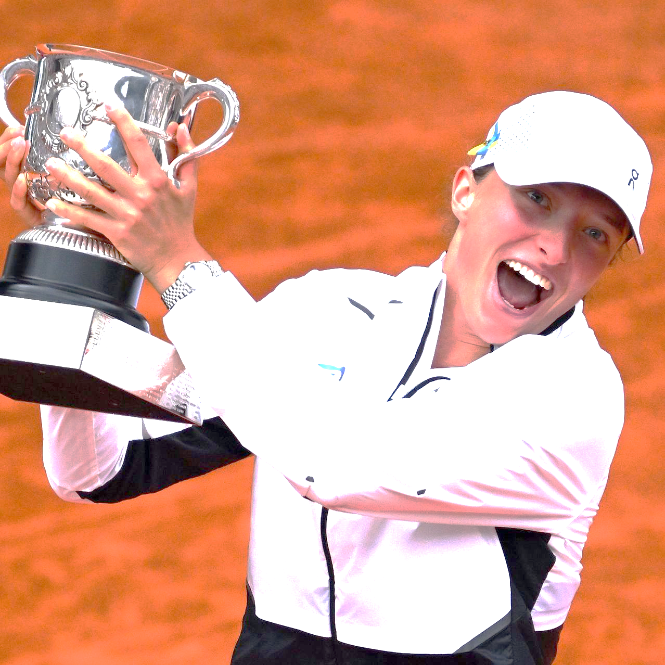
Who is the best?
Name | Rank
Swiatek, Iga | 1
Alcaraz, Carlos | 2
Sabalenka, Aryna | 2
Medvedev, Daniil | 3
Gauff, Cori | 3
Sinner, Jannik | 4
Rybakina, Elena | 4
Pegula, Jessica | 5
Jabeur, Ons | 6
Zverev, Alexander | 7
Vondroušová, Markéta | 7
Rune, Holger | 8
Krejcikova, Barbora | 10
swiatek-iga

Slide 8
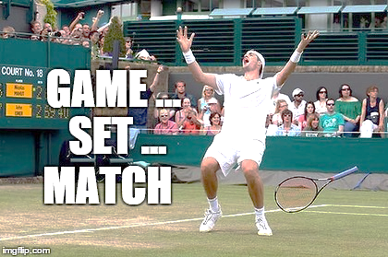
Average statistics
9 Games per set
2 Sets per match

Slide 9

Matches Duration Info.
Average match record
100 min
1 hour and 40 minutes
Longest match record
214 min
3 hours and 34 minutes

Slide 10
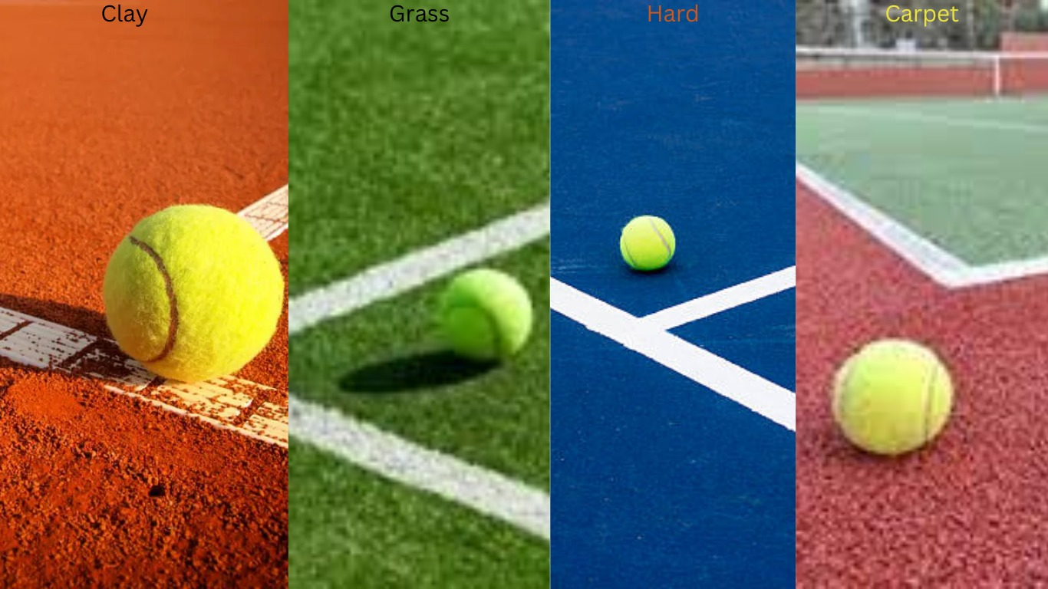
Ground Types
Ground type | count
Carpet indoor | 3
Hardcourt indoor | 84
Hardcourt outdoor | 336
Red clay | 323
Synthetic outdoor | 1

Slide 11
average number of aces per match: 4
number of double faults:
Female: 6
Male: 2

Slide 12




Tournaments

Slide 13
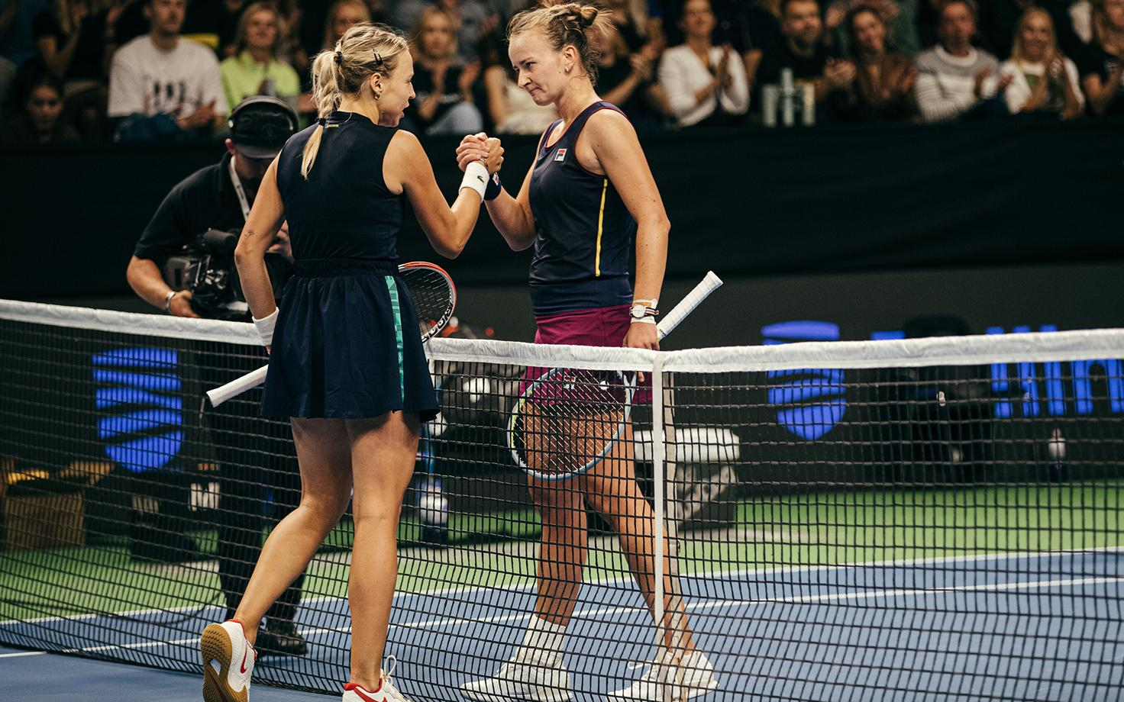
Analysis

Slide 14
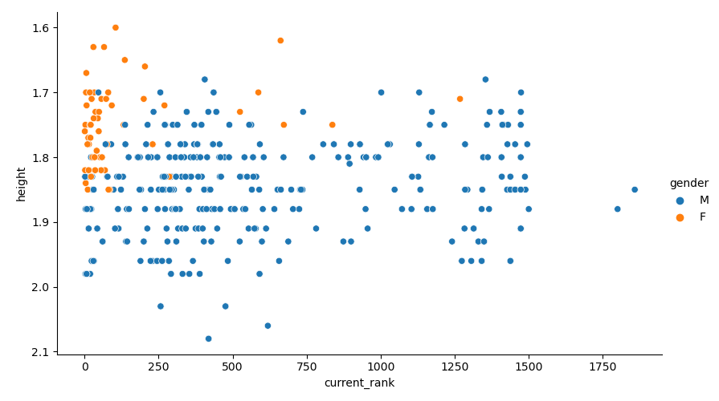
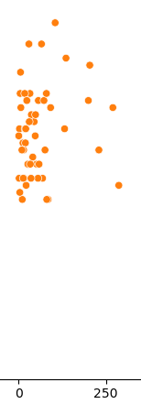
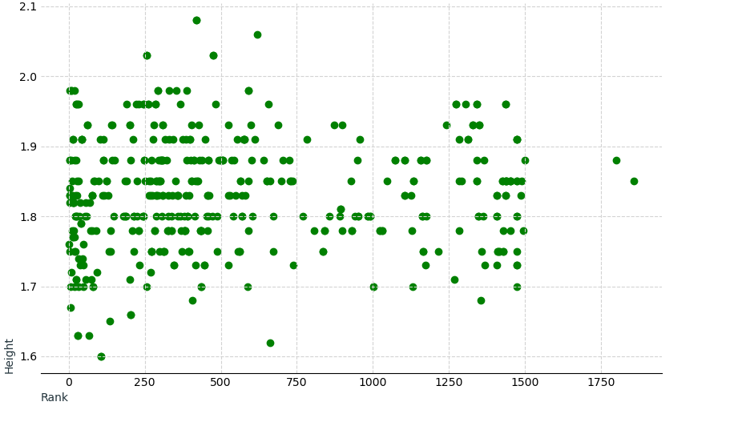
Correlation Between Players’ Height and Rank

Slide 15
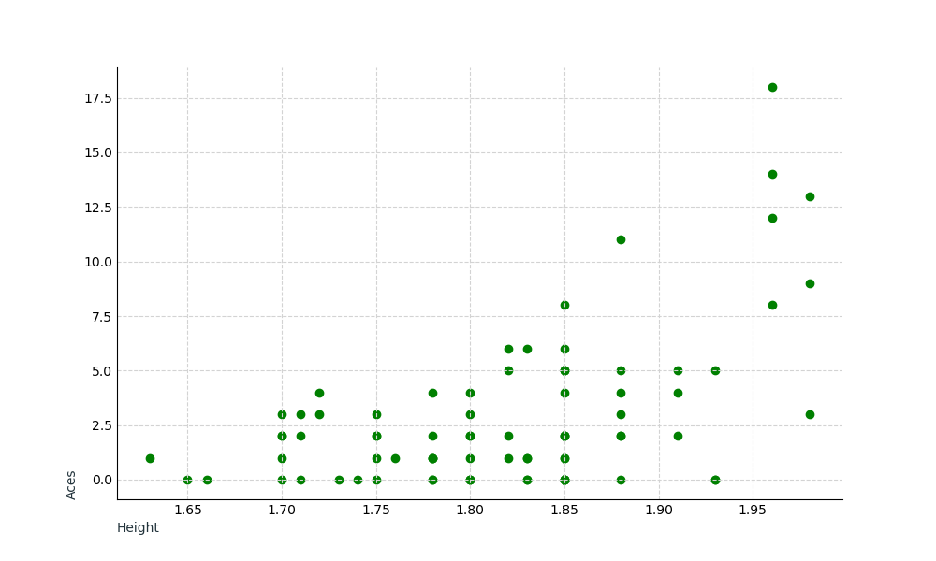
Correlation Between Home Players’ Height and Aces

Slide 16
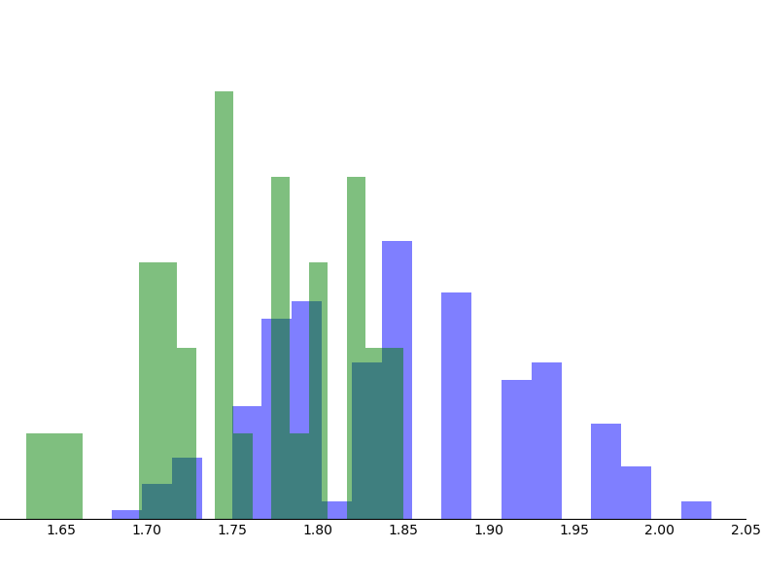
Players’ Height Histogram based on gender
Female
Male

Slide 17
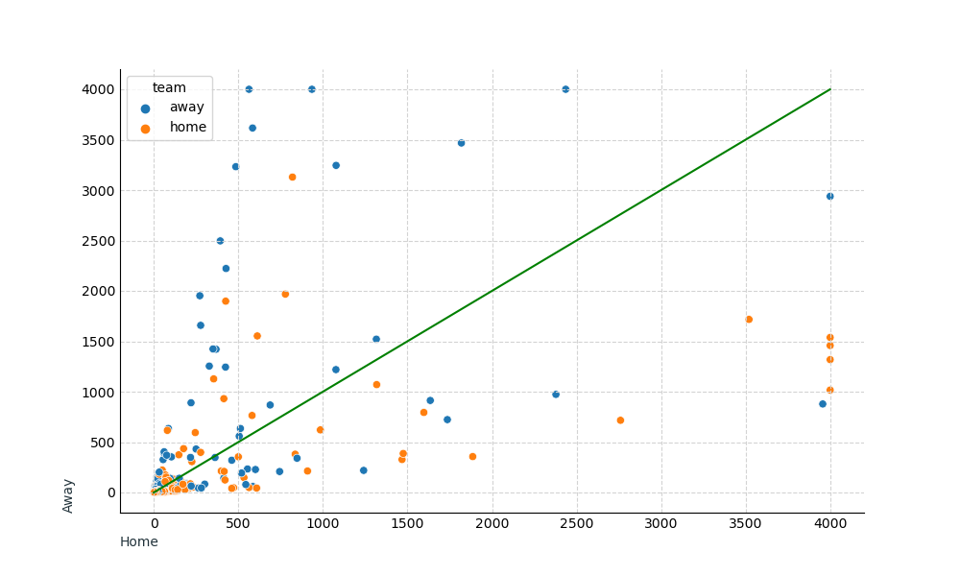
Matches Prediction: Correct or Incorrect

Slide 18
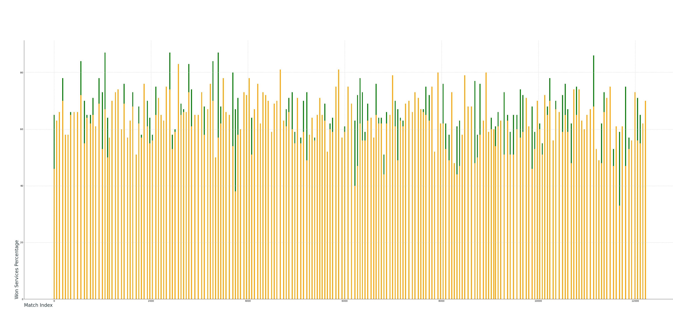
First Serve Success based on Home and Away
Home Away

